Slide 1


Operations Team Training
Defined Tasks & Expectations

Slide 2
Agenda
Event Day Details
Team Assignments/Task Schedule
Lessons Learned

Slide 3
Event Day Details
Time | Action
7:00-7:10am | Report to Ops Manager - Receive Assignment Folder
7:10-8:00am | Complete all assignments - defined in Assignment Folder
8:00-8:40am | Volunteers arrive - begin check in
8:40-9:00am | Volunteers board buses or walk to destinations

Slide 4
Nani - Set Up
224-401-7135
maddirsh@mail.uc.edu
Olivia White - Check In
859-803-2045
whiteoa@mail.uc.edu
Team Manager

Slide 5
Olivia White - Check In
859-803-2045
whiteoa@mail.uc.edu
Check In Team
Leader | Check In Team | Check In Instructor (7:30am)
Brooke Robertson | Avondale
Ananya Handa | Avondale
Laura Warner | Avondale
Hirdayesh Shrestha | Avondale
Bekah Aylward | Avondale
Tyler Watson | Westwood
Natalie Kokoska | Westwood
Katie Martin | Westwood
Austin Miller | Westwood
Susan Kelley | Westwood
Brianne King | OTR
Bryce Huskey | OTR
Venancio Quiambao | OTR
Miguel Signey | OTR
Leader | Check In Team | Check In Instructor (7:30am)
Isaac Harmon | OTR
Jacob Sheff | MLK
Robert Gengler | MLK
Serene Smith | MLK
Sean Malone | Ravine
Jonah Lewis | Ravine
Jared Hansen | Ravine
Hassan Jamil | Vine
Sangya Pandey | Vine
Tyler Barrett | Vine
Notes:
34 prints

Slide 6
Check-In Crew - Task Schedule
7:00-7:10am: Receive Assignment folder from Olivia
Get laptops from Lindner room
Report to assigned team check-in area (2 people/table)
7:10-7:45am: Assist with table, tablecloth and chair set-up in your area
7:50-8:45am: Check In volunteers; Be quick & efficient
*Roster Master Sheet inside folder
On the spot Check in through www.volunteer.uc.edu , asign random
Direct volunteer to assigned crew leader
*Crew leader name will be next to volunteer’s name on roster
*Instruct volunteer to grab gloves & 3 garbage bags
9:00-11:00 am: Add hours in Lindner room. Instructions will be given by Olivia.

Slide 7
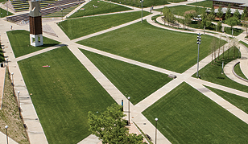
S
Supplies (garbage bags & gloves)
F
Food & Water
Walnut Hills
OTR
S
F
S
Ravine
S
F
Vine
S
S
S
F
S
S
F
Avondale
Westwood

Slide 8
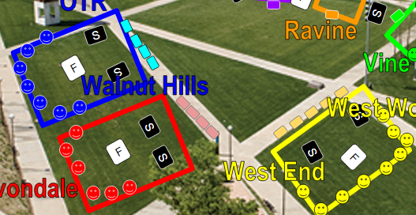
Supply Management

Slide 9
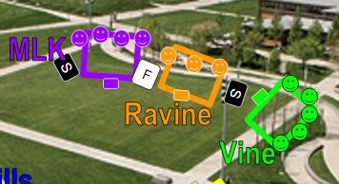
Supply Management

Slide 10
Set Up Crew - Task Schedule

Slide 11
Set Up Team
 | Tents/Banners/Ropes/ Tablecloths/Greeters | Tables/Chairs/Bus Guide | Bags/Gloves/Food/Bus Guide
Leader | Marnie Bing Kiet Vineela Rucha Theo | Tosha Philip Sagar Ireland Bella Hong-Yang Lin | Ryan Mark Christina Jordan Elizabeth
Task Details | 7:00am: Delivery of 6 tents at Turner Circle - place tents in area shown on layout sheet (in your folder) *Vendor: A1 Rentals *Contact Info: 7:15am: Retrieve zip ties, banners and tablecloths from storage room in Lindner 110 *Nani will direct Note: OTR, Avondale and West End have ropes 7:50am: Greet arriving volunteers | 7:00am: Delivery of 30 tables and 30 chairs at Turner Circle 7:15am: Set up tables according to layout sheet provided Vendor: Mike from Decorative Rentals Contact: 513-256-3180 | 7:00am: Retrieve bags and gloves from storage room in Lindner 110 *Nani will direct 7:15am: Coffee/bagels/juice being delivered at Turner Circle by Order Up 7:30am: Place food/drinks and supplies according to layout sheet provided in your folder
Nani - Set Up
224-401-7135
maddirsh@mail.uc.edu
Notes:
27 prints

Slide 12
Bus Guides
Bus Sign | Intersection | Bus Guide | Crew Leaders on your bus | Note
N Avondale | Avon Fields | Tosha
Avondale | Forest & Reading Ave | Phillip |  | Will make 2 trips - wait until bus comes again for 2nd pick up
OTR - W | 1st trip: Elm St & W. Liberty 2nd trip: Vine & E. Liberty | Sagar |  | Will make 2 trips - wait until bus comes again for 2nd pick up
OTR - E | Kroger Lot - 954 E. McMillan | Ireland
Walnut Hills | 770 E. McMillan St | Ryan
Westwood- QC | Queen City & Harrison Ave | Mark
Westwood - B | Waverly & Beekman St | Christina
West End | Linn & W. Liberty St | Jordan
District 5 | 3005 Colerain Ave
 |  | Bella

Slide 13
After volunteers leave
Bring tables/tents/chairs back to Turner Circle.
Put rest of the stuff: folders, laptops, signs, and supplies in the car.
Clean Sigma Sigma
Return material to Langsam and Stratford Heights.
Greet Returning volunteers/ Give out extra food.

